Slide 1
Software Engineering for Machine Learning:
A Case Study

Slide 2
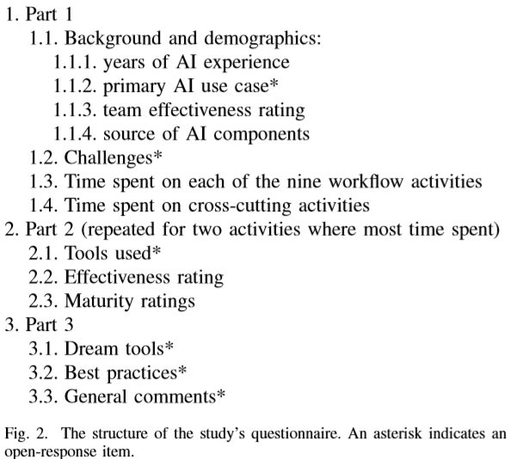
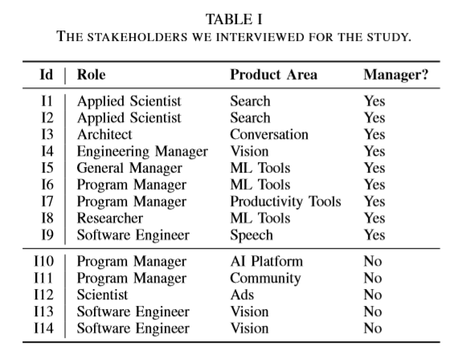
Background
Notes:
实际上很多人的报告，有一个基于关系的迁移，比如源领域数据中潜在一种师生关系，而目标领域潜在有上下级关系；生物病毒传播---网络病毒传播。

Slide 3
Contributions
A description of how several Microsoft software engineering teams work cast into a nine-stage workﬂow for integrating machine learning into application and platform development.
A set of best practices for building applications and platforms relying on machine learning.
A custom machine-learning process maturity model for assessing the progress of software teams towards excellence in building AI applications.
A discussion of three fundamental differences in how software engineering applies to machine-learning–centric components vs. previous application domains.
Notes:
实际上很多人的报告，有一个基于关系的迁移，比如源领域数据中潜在一种师生关系，而目标领域潜在有上下级关系；生物病毒传播---网络病毒传播。

Slide 4
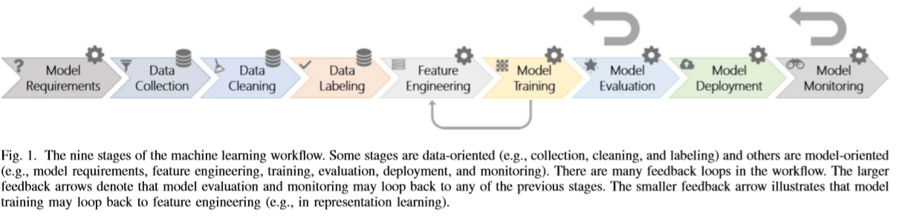
Workflow
Notes:
实际上很多人的报告，有一个基于关系的迁移，比如源领域数据中潜在一种师生关系，而目标领域潜在有上下级关系；生物病毒传播---网络病毒传播。

Slide 5
Best Practices
End-to-end pipeline support
1) unifying and automating the day-to-day workﬂow
2) crock solid, data pipeline, capable of continuously loading and massaging data
3) develop openly available IDEs to enable Microsoft’s customers to build and deploy their models (e.g. Azure ML for Visual Studio Code3 and Azure ML Studio4)
Data availability, collection, cleaning, and management
1) the success of ML-centric projects often heavily depends on data availability, quality and management
2) reuse the data as much as possible to reduce duplicated effort
3) accessibility, accuracy, authoritativeness, freshness, latency, structuredness, ontological typing, connectedness, and semantic joinability
4) blend data management tools with their ML frameworks
Notes:
实际上很多人的报告，有一个基于关系的迁移，比如源领域数据中潜在一种师生关系，而目标领域潜在有上下级关系；生物病毒传播---网络病毒传播。

Slide 6
Best Practices
Education and Training
1) engineers with traditional software engineering backgrounds need to learn how to work alongside of the ML specialists
Model Debugging and Interpretability
1) Understanding when and how models fail to make accurate predictions is an active research area
2) propose to use more interpretable models, or to develop visualization techniques that make black-box models more interpretable
Notes:
实际上很多人的报告，有一个基于关系的迁移，比如源领域数据中潜在一种师生关系，而目标领域潜在有上下级关系；生物病毒传播---网络病毒传播。

Slide 7
Best Practices
Model Evolution, Evaluation, and Deployment
1) ML-centric software goes through frequent revisions initiated by model changes, parameter tuning, and data updates
2) it is important to employ rigorous and agile techniques to evaluate their experiments
3) Automating tests is as important in machine learning as it is in software engineering; teams create carefully put-together test sets that capture what their models should do
4) it is important that a human remains in the loop
5) not only to automate the training and deployment pipeline, but also to integrate model building with the rest of the software
Compliance
1) fairness, accountability, transparency, and ethics
Notes:
实际上很多人的报告，有一个基于关系的迁移，比如源领域数据中潜在一种师生关系，而目标领域潜在有上下级关系；生物病毒传播---网络病毒传播。

Slide 8
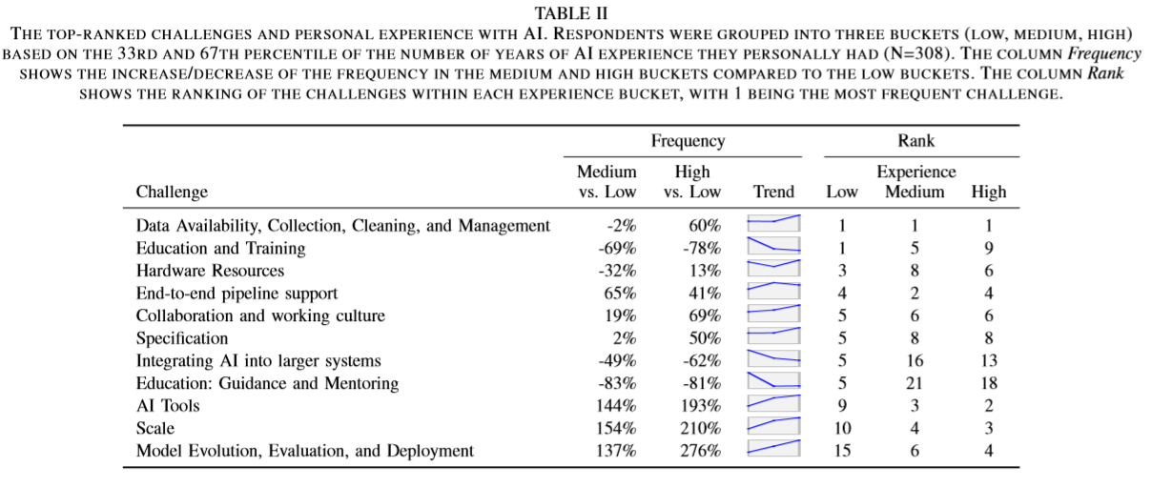
Best Practices
Varied Perceptions
Notes:
实际上很多人的报告，有一个基于关系的迁移，比如源领域数据中潜在一种师生关系，而目标领域潜在有上下级关系；生物病毒传播---网络病毒传播。

Slide 9
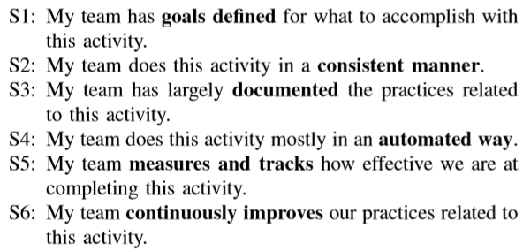
Maturaity Model
Activity Maturity Index (AMI)
Activity Effectiveness (AE)
“How effective do you think your team’s practices around this activity are on a scale from 1 (poor) to 5 (excellent)?”
The Spearman correlation between the Maturity Index and the Effectiveness was between 0.4982 and 0.7627 (all statistically signiﬁcant at p<0.001)
Notes:
实际上很多人的报告，有一个基于关系的迁移，比如源领域数据中潜在一种师生关系，而目标领域潜在有上下级关系；生物病毒传播---网络病毒传播。

Slide 10
Three Fundamental Differences
Data discovery and management
1) software engineering is primarily about the code that forms shipping software. ML is all about the data that powers learning models.
2) Engineers have to ﬁnd, collect, curate, clean, and process data for use in model training and tuning. All the data has to be stored, tracked, and versioned.
3) While software APIs are described by speciﬁcations, datasets rarely have explicit schema deﬁnitions to describe the columns and characterize their statistical distributions.
4) due to the rapid iteration involved in ML, the data schema (and the data) change frequently, even many times per day.
Notes:
实际上很多人的报告，有一个基于关系的迁移，比如源领域数据中潜在一种师生关系，而目标领域潜在有上下级关系；生物病毒传播---网络病毒传播。

Slide 11
Three Fundamental Differences
Customization and Reuse
1) In software, the primary units of reuse are functions, algorithms, libraries, and modules. A software engineer can ﬁnd the source code for a library (e.g. on Github), fork it, and easily make changes to the code, using the same skills they use to develop their own software
2) Although fully-trained ML models appear to be functions that one can call for a given input, the reality is far more complex. One part of a model is the algorithm that powers the particular machine learning technique being used (e.g., SVM or neural nets). Another is the set of parameters that controls the function
Notes:
实际上很多人的报告，有一个基于关系的迁移，比如源领域数据中潜在一种师生关系，而目标领域潜在有上下级关系；生物病毒传播---网络病毒传播。

Slide 12
Three Fundamental Differences
ML Modularity
1) Another key attribute of engineering large-scale software systems is modularity. Modules are separated and isolated to ensure that developing one component does not interfere with the behavior of others under development, and Module interactions are controlled by APIs.
2) Maintaining strict module boundaries between machine learned models is difﬁcult for two reasons. First, models are not easily extensible. Second, models interact in non-obvious ways.
Notes:
实际上很多人的报告，有一个基于关系的迁移，比如源领域数据中潜在一种师生关系，而目标领域潜在有上下级关系；生物病毒传播---网络病毒传播。

